Slide 1


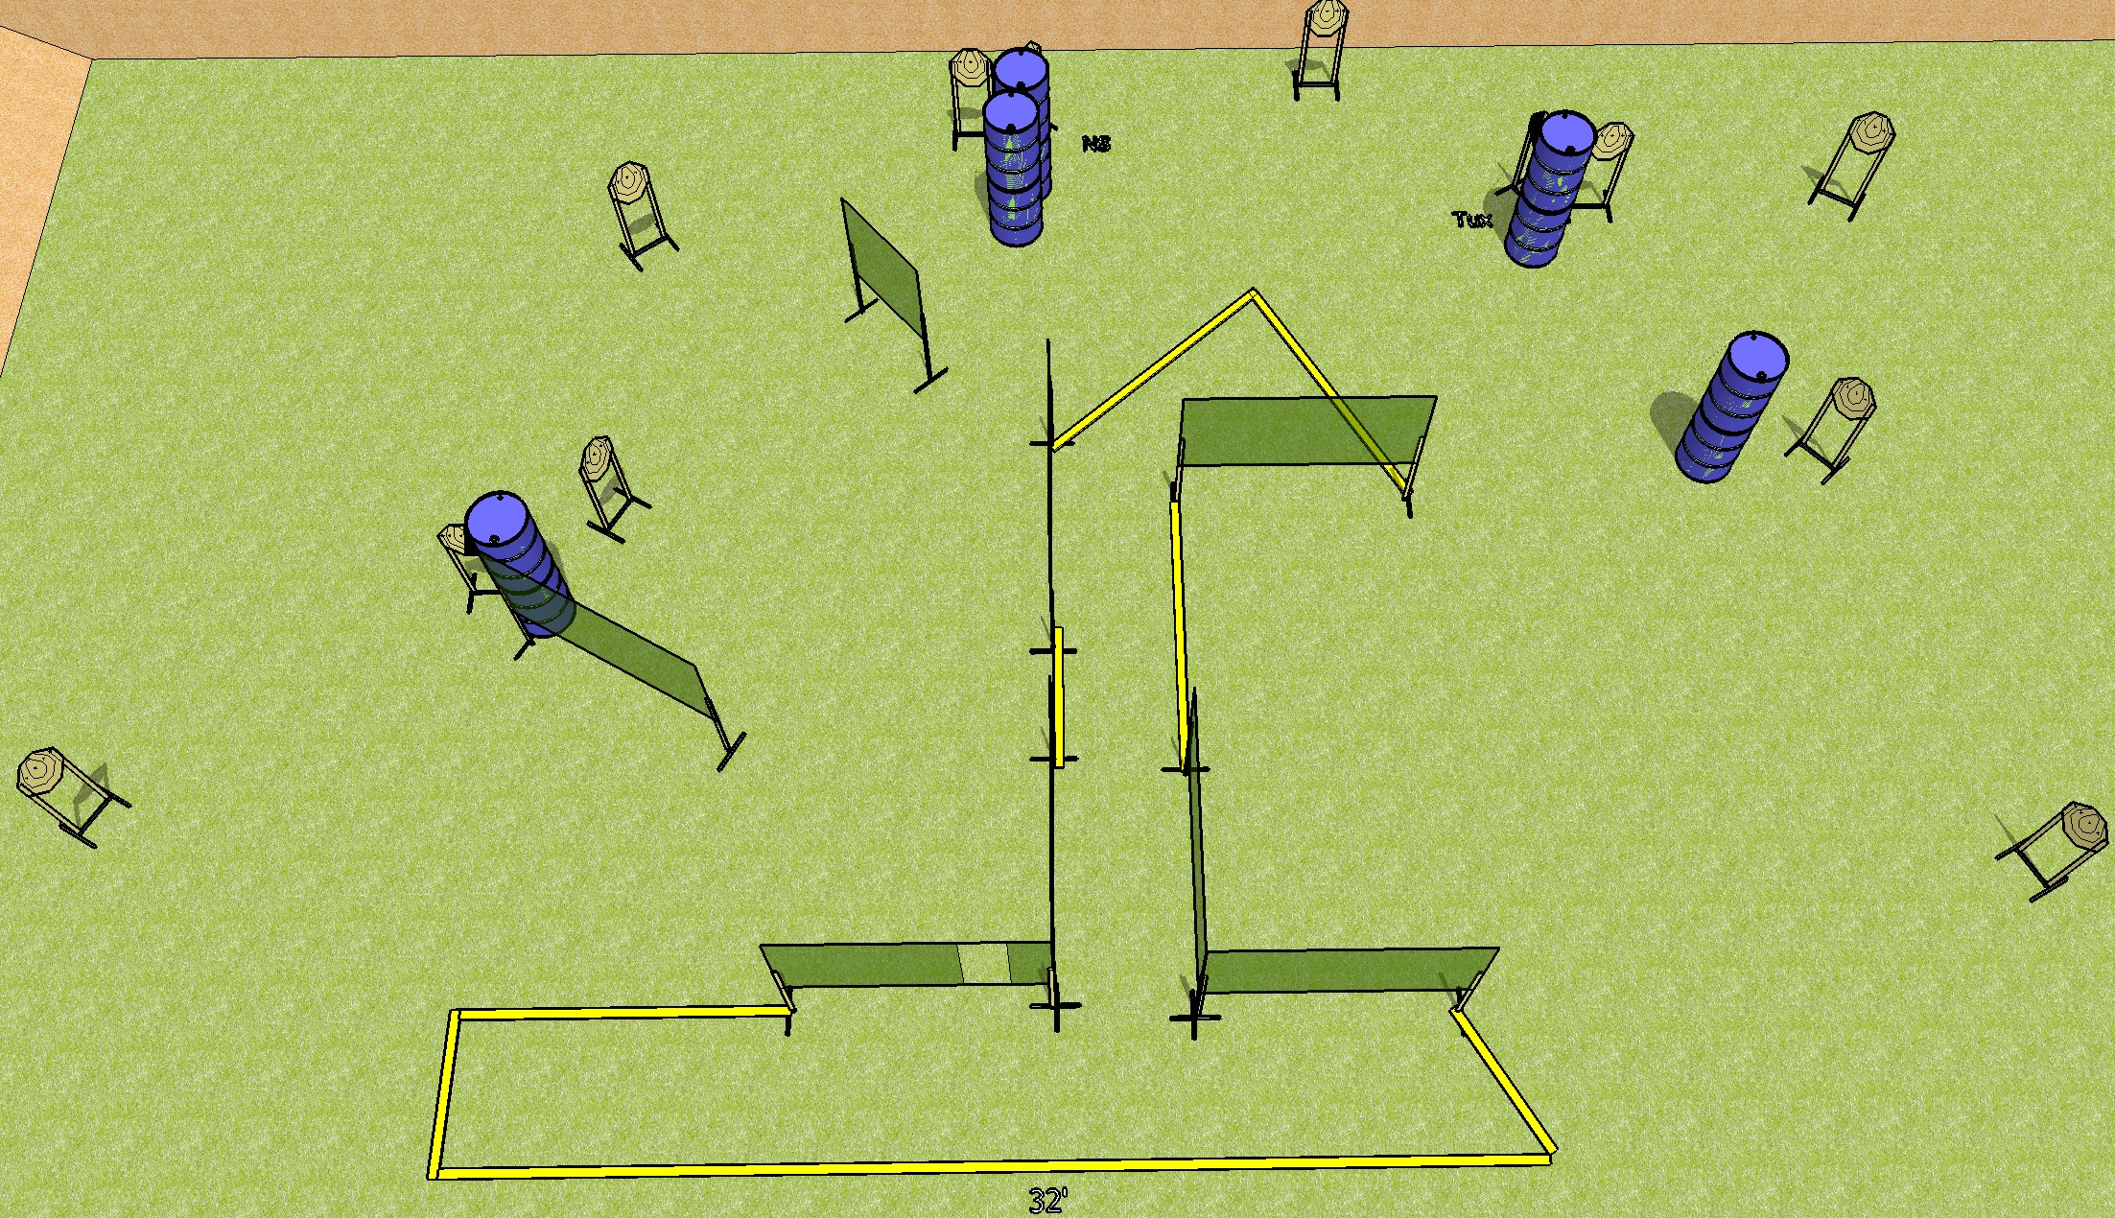
 | Dothan Gun Club – USPSA Match Done Done Done Course Designer : Drew Coleman Bay: B3
Round Count 24 rounds 12 IPSC
Equipment List 14 wall feet 1 tux 12 targets (11 + 1NS)

Slide 2
Done Done Done
Written Stage Briefing
Scoring: Comstock Rounds: 24
Targets: 12 IPSC
Handgun start position: feet on X’s, wrists below belt. Handgun is loaded and holstered.
PCC start position: feet on X’s, stock on belt. Loaded carbine is held with both hands, safety on.
Stage Procedure: on the audible start signal, engage targets as they become available from within the shooting area.

